Slide 1
StatCast Dashboard: Exploration of Spatiotemporal Baseball Data
By Marcos Lage, Jorge Piazentin Ono and Daniel Cervone, Justin Chiang, Carlos Dietrich and Claudio T. Silva
Presented by: Abhijit Talla (U78420535)

Slide 2
StatCast. (Hardware & software practices for analysis)
Dashboard (Proposed System)
Exploration (Learning new things)
Spatiotemporal (deals with space and time)

Slide 3
STatcast
Released in 2015 by MLB.com (Major League Baseball).
Uses player and ball location to capture game plays.
Ballpark sensors and various software approaches.
Gameplay.
Stores data, videos, plays and metrics.

Slide 4
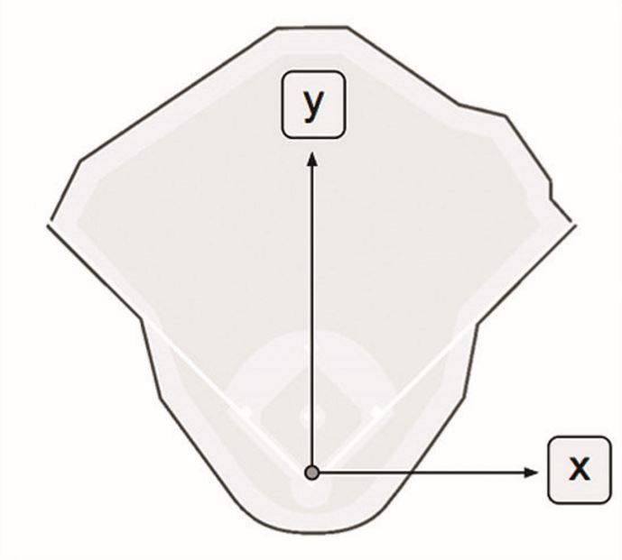
StatCASt
Coordinate System:
(x , y) measurements.
X-axis parallel to 1st & 3rd bases.
Y-axis points to pitcher’s mound.
(0 , 0) batter’s position.

Slide 5
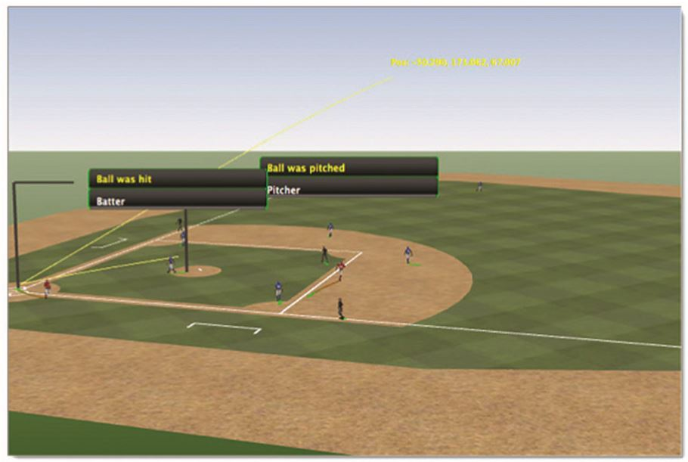
statcast
Player & ball tracking:
Player tracking is done through ChyronHego Tracab.
Ball tracking is done through Trackman radar technology.

Slide 6
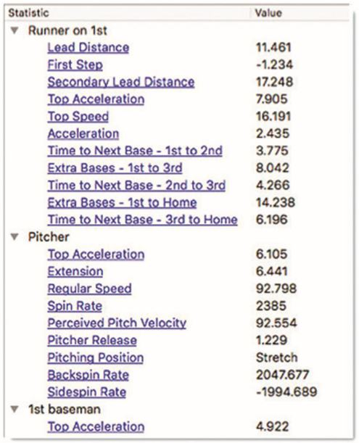
statcast
Metrix Engine:
Displays player and ball related data.

Slide 7
STATCAST Dashboard
Tasks:
T1: Easy to query and analyze the data.
T2: Should be able to visualize groups of gameplays.
T3: Should be able to filter using Metrics.
T4: Should be able to draw over the system to select appropriate data.
T5: Should be able to download the data.

Slide 8
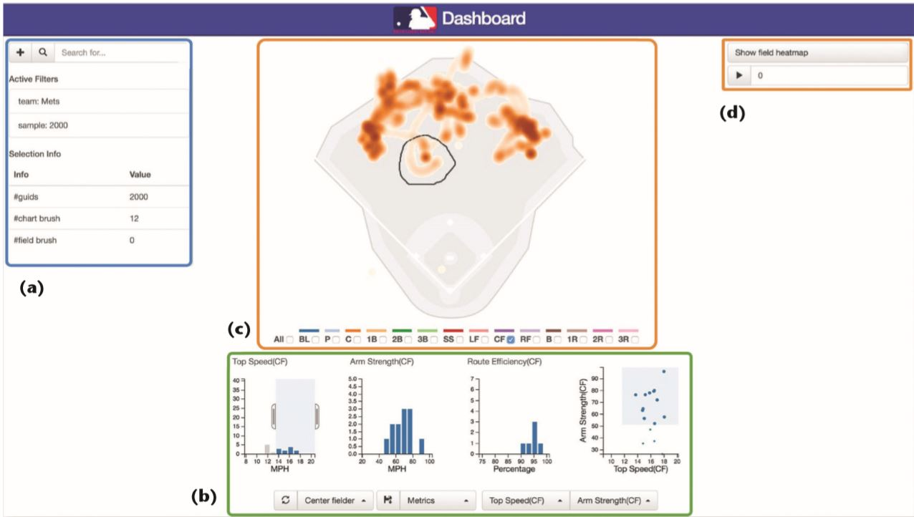
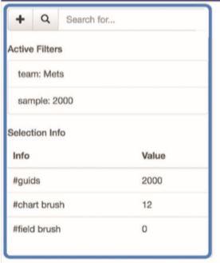
Statcast dashboard
Keyword Manager:
To query the gameplays.
syntax keyword:value1[,value2,...,valueN]
keywords: team, vs, date, pitcher, batter, fielder, game_id, play_id, limit, and sample.
vs: Yankees, Mets.

Slide 9
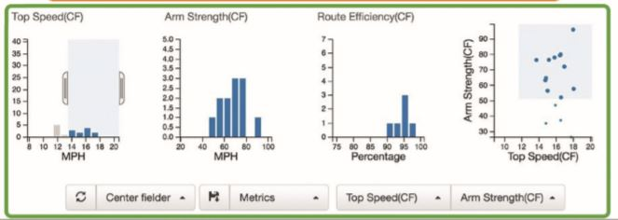
STATCAST DASHBOARD
Stats Viewer and Filtering:
Provides histogram data for each keyword in queries.
Scatterplot is combination of two keywords.

Slide 10
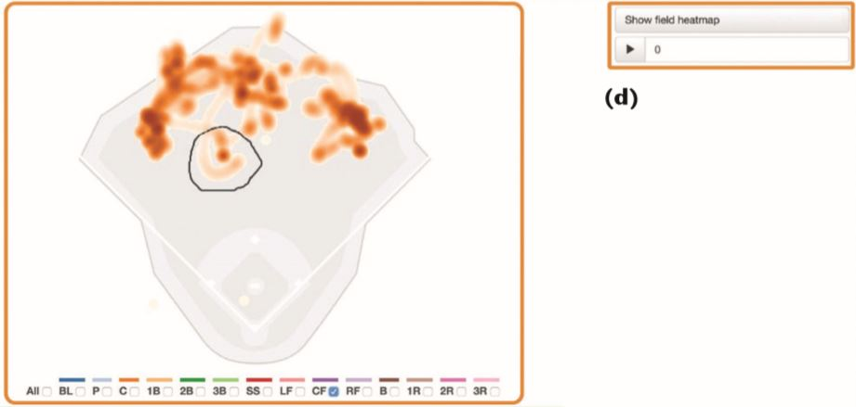
Statcast dashboard
Gameplay Viewer & Filtering:
Heatmaps for the selected data.
Mouse dragger to select the specific data.

Slide 11
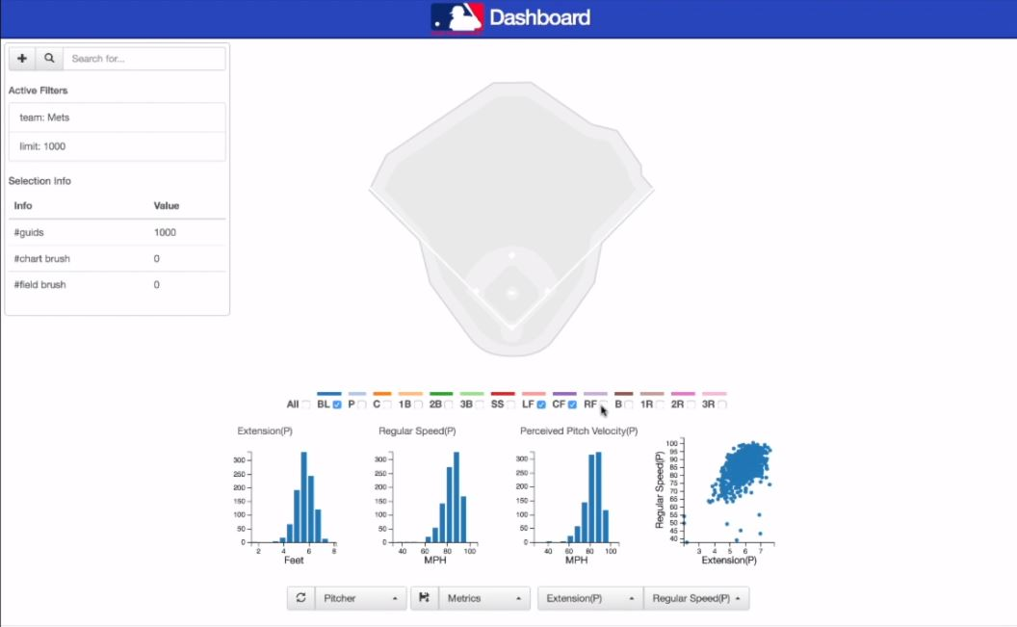
Use case example - 1

Slide 12
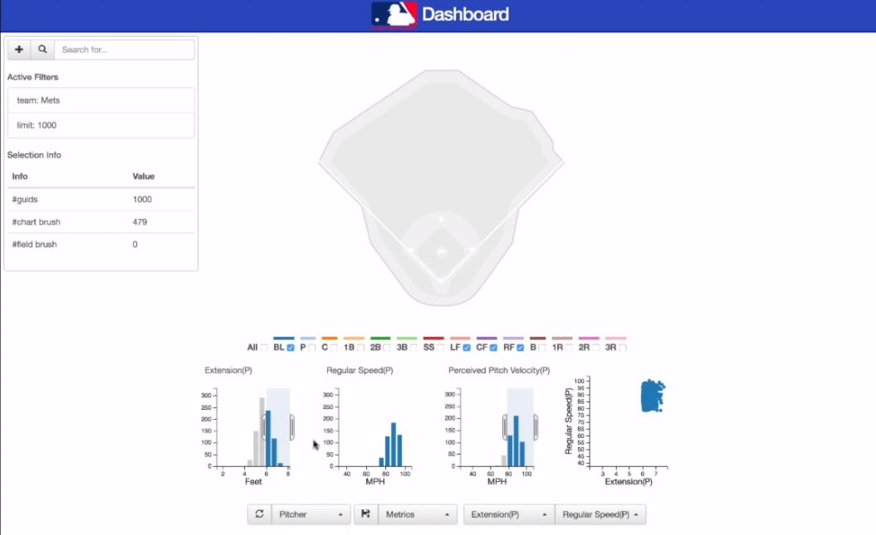
Use case example - 1

Slide 13
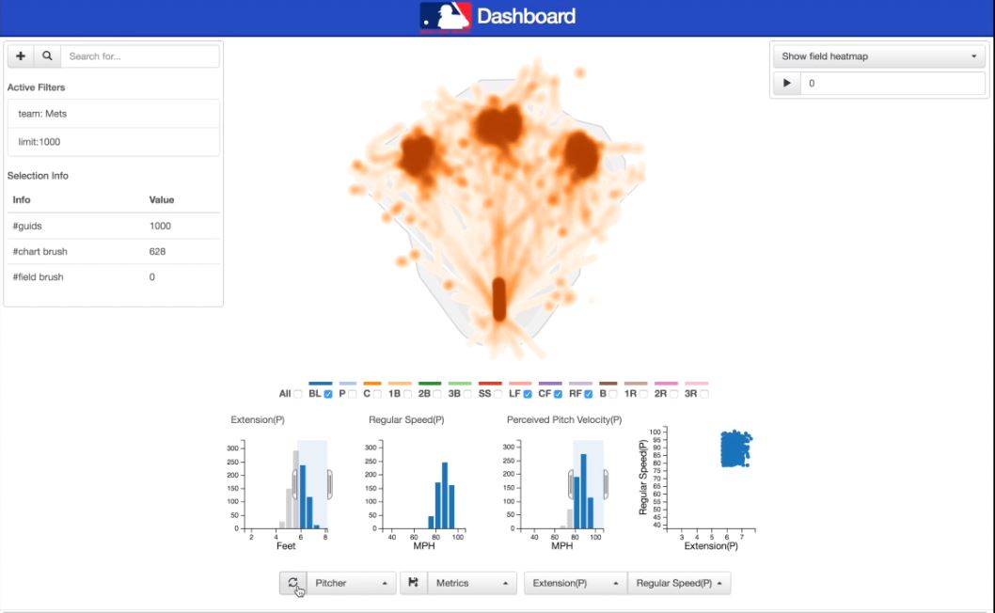
Use case example - 1

Slide 14
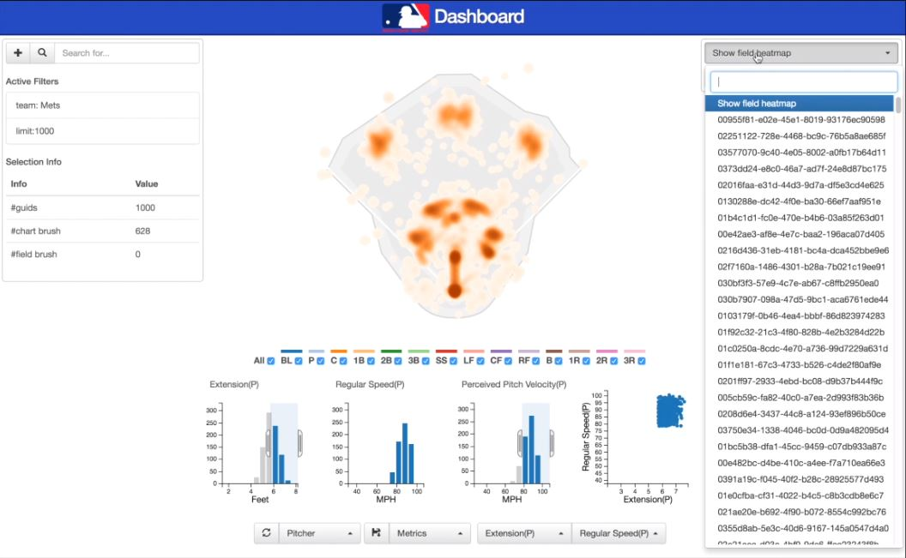
Use case example - 1

Slide 15
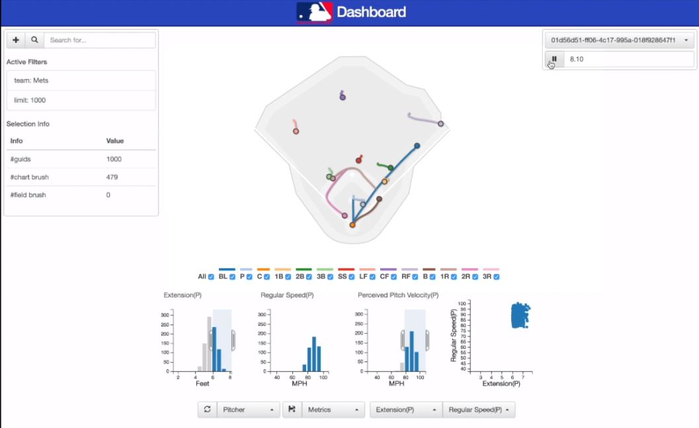
Use case example - 1

Slide 16
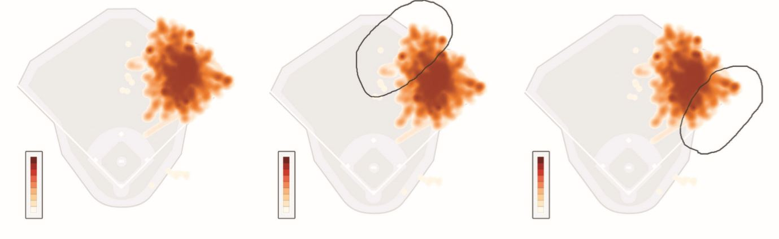
Use case example - 2
Harper’s left and right side movements are selected from game play viewer to export them into csv files and further analyze his acceleration using Python or R coding practices.

Slide 17
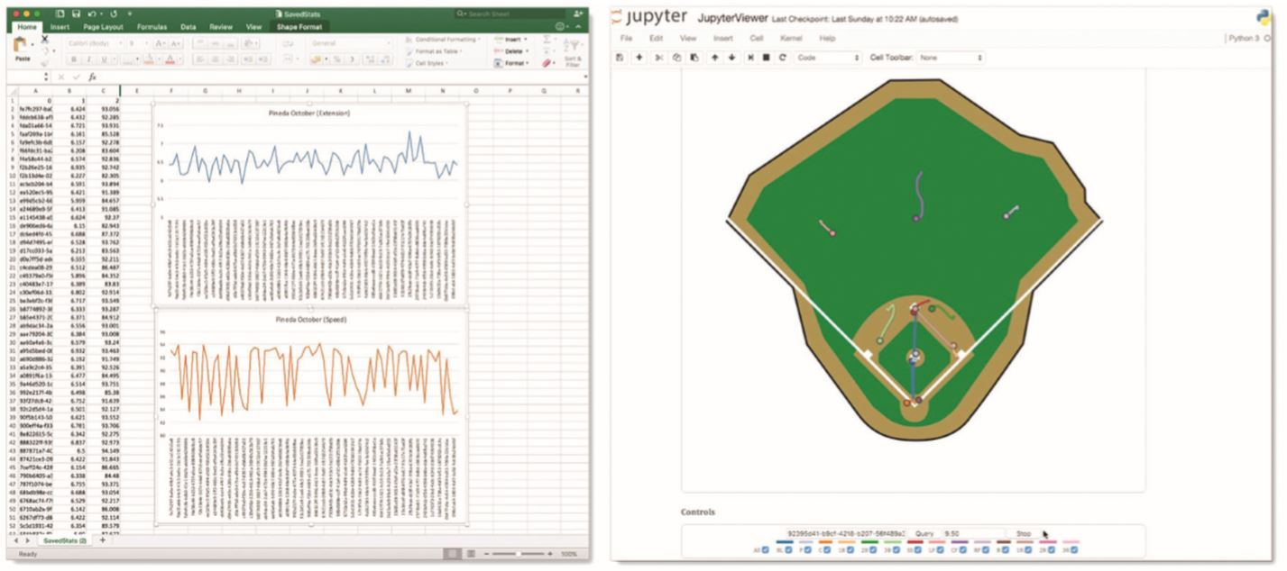
Use case example -2

Slide 18
References
J. Borg, “Detecting and Tracking Players in Football Using Stereo Vision,” master’s thesis, Dept. Electrical Eng., Linköping Univ., 2007.
C. Dietrich et al., “Baseball4D: A Tool for Baseball Game Reconstruction and Visualization,” Proc. IEEE Conf. Visual Analytics Science and Technology (VAST), 2014, pp. 23–32.
H. Samet, The Design and Analysis of Spatial Data Structures, Addison-Wesley, 1990.

Slide 19
Thank You.

